Slide 1

B.Tech Project
Bifurcation Analysis
of a System of ODEs
Name: Shubham Kumar (22MC3032)
Branch: Mathematics & Computing
Supervisor: Dr.Soniya Dhama

Slide 2
Contents
Table Of Contents
01
Introduction to Bifurcation Analysis (Theory)
03
Case Studies: Logistic Map
An overview of bifurcation theory and its importance in understanding dynamical systems.
Detailed analysis of the Logistic Map as examples of bifurcation and chaos.
02
Lorenz System
04
Applications and Conclusion
Detailed analysis of the Lorenz System as examples of bifurcation and chaos.
Practical applications of bifurcation theory and a summary of insights from the study.

Slide 3
Bifurcation Theory
It studies qualitative changes in the behavior of dynamical systems as parameters vary.
Bifurcation is the phenomenon in a dynamical system where a small change in a parameter causes a qualitative change in its long-term behavior, such as the creation or destruction of equilibrium points, periodic orbits, or the transition to chaos. It marks a critical point where the system's structure or stability changes fundamentally, often leading to new patterns or dynamics.
Types of Systems Studied:
Applied to continuous systems (e.g., differential equations) and discrete systems (e.g., maps).
Connections to Chaos Theory:
Bifurcation theory is linked to chaos theory, helping analyze and predict nonlinear systems' behavior.
General Overview
History

Slide 4


Bifurcation Theory
Chaos:
Chaos is unpredictable behavior in deterministic systems governed by equations. Small changes in starting conditions can lead to very different outcomes, making it seem random even though it’s not. Chaotic systems often show irregular patterns and settle into unique shapes called strange attractors.
Bifurcations explain how small parameter changes cause drastic shifts in system behavior, while chaos describes unpredictable, yet deterministic, system dynamics.
Ordinary Differential Equation (ODE):
An ODE is a mathematical equation that relates a function with its derivatives. It describes how a quantity changes with respect to another, typically time. The equation involves one independent variable and its derivatives and can be written as:
$$\frac{dy}{dx}=f(x,y)$$

Slide 5
“Tracing the roots”
Early Foundations: Contributions by Fourier, and Markov in the 18th and 19th centuries laid the groundwork for bifurcation theory.
Visualization Tool: Gaston Julia introduced bifurcation diagrams in the 1920s, providing a way to visualize system transitions.
Modern Formulation: Smale and Thom developed abstract frameworks for bifurcation theory in the mid-20th century, including catastrophe theory.
Chaos and Universality: Feigenbaum discovered the universal constant related to period-doubling bifurcations in 1978, linking bifurcations to chaos.
Ongoing Impact: Bifurcation theory continues to evolve, with applications in physics, biology, engineering, and economics.
Problem
Nonlinear systems often exhibit complex behaviors, such as bifurcations and chaos, that are difficult to predict and analyze.
Understanding how parameters influence the transition from stability to chaos is critical for improving predictions and system design.

Slide 6
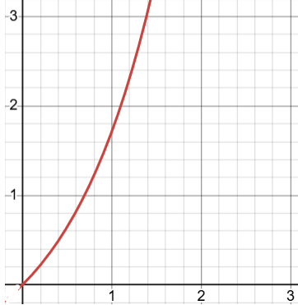
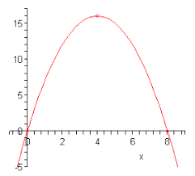

Logistic Map
$$X_{n+1}=rX_{n}$$
$X_{n+1}=rX_{n}$(1- $X_{n}$)
X is a percentage of the theoretical maximum so it goes
from 0 to 1 and as it approaches the maximum then, (1-X)
becomes 0 and this constraint the population.

Slide 7

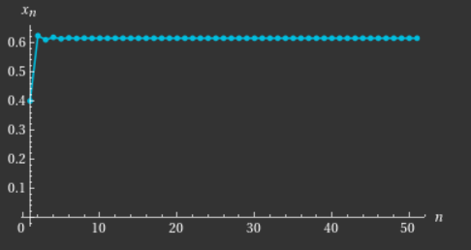
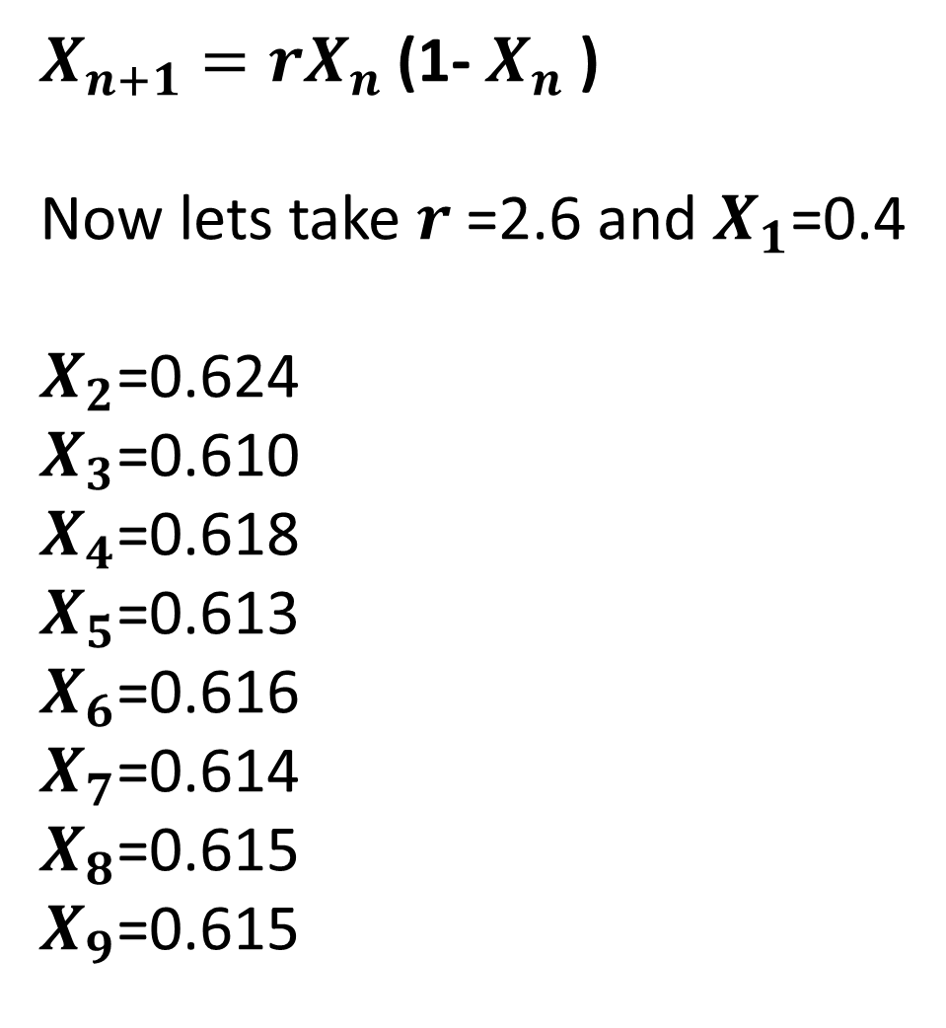
$X_{n+1}=rX_{n}$(1- $X_{n}$)
Now lets take $r$=2.6 and $X_{1}$=0.4 $X_{2}$=0.624
$X_{3}$=0.610
$X_{4}$=0.618
$X_{5}$=0.613
$X_{6}$=0.616
$X_{7}$=0.614
$X_{8}$=0.615
$X_{9}$=0.615

Slide 8
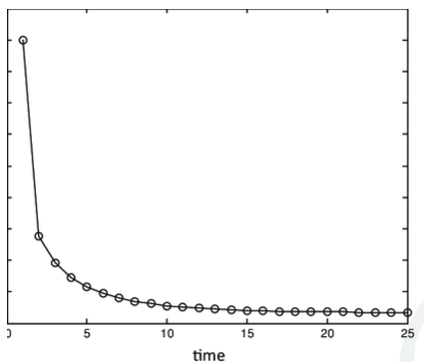
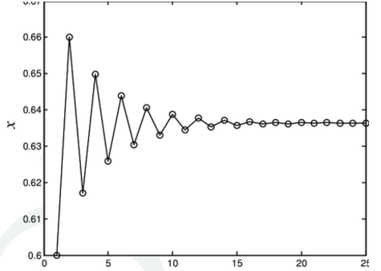
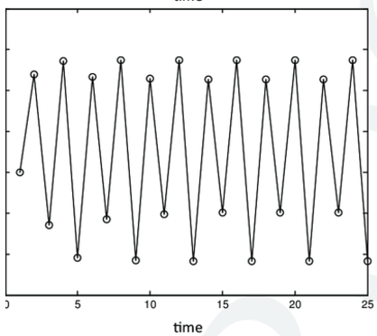
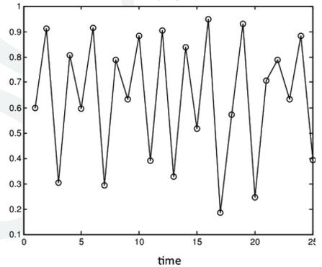
$$r<1 1<r \text{<3 3<}r \text{<3.}57 r \text{>3.57}$$
There is no change in the graph structure with the change of the $X_{1}$ (initial condition)
But the Graph structure changes with the change $r$(rate of growth).

Slide 9
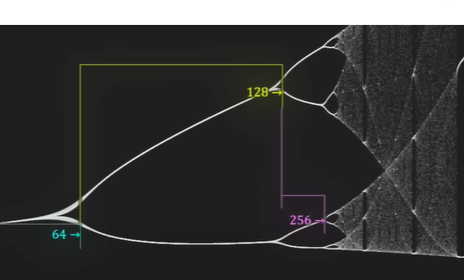
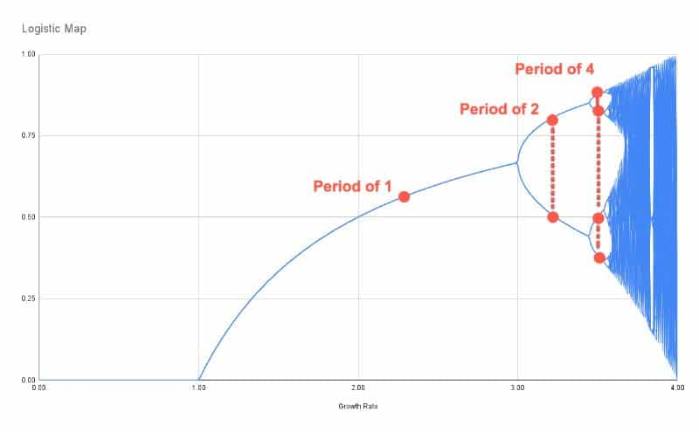
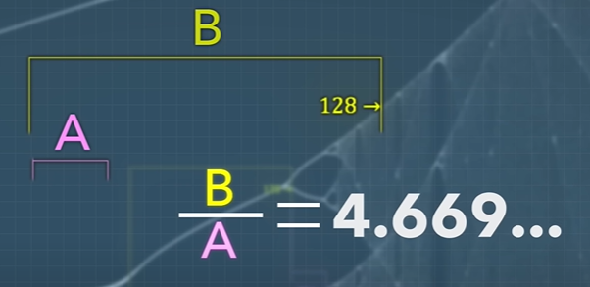

Feigenbaum Constant
$$X_{n+1}=r{ Sin(X}_{n})$$

Slide 10
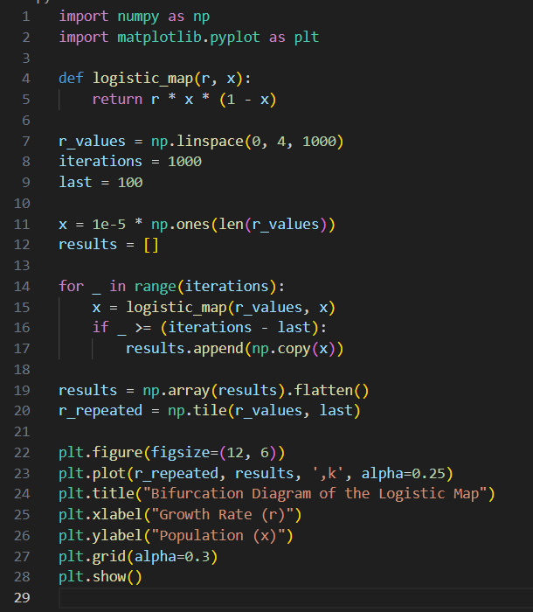
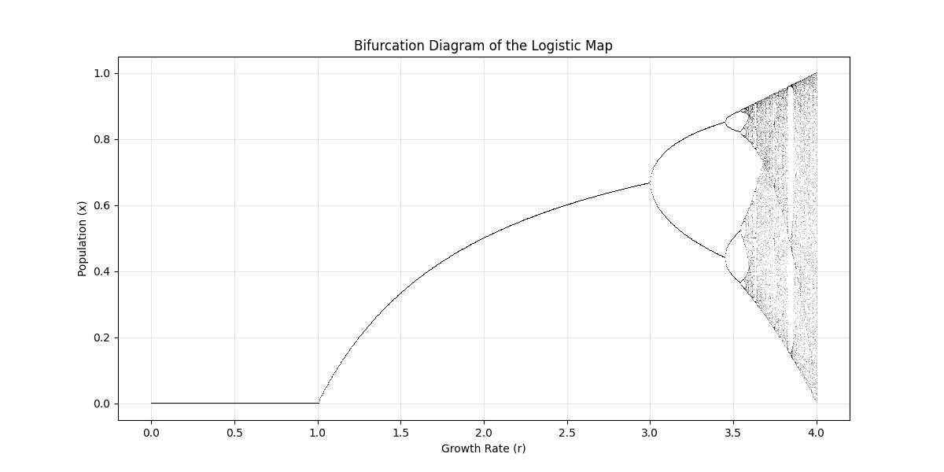
Python Code for Logistic Map
Output:

Slide 11

Lorenz System
The Lorenz System is a set of three coupled, first-order, nonlinear differential equations:
$$\frac{dx}{dt}=σ\left(y−x\right) ,$$
$$\frac{dy}{dt}=x\left(ρ−z\right)−y ,$$
$$\frac{dz}{dt}=xy −βz ,$$
where:
x, y, z: State variables representing physical quantities (e.g., convection intensity, temperature difference).
σ: Prandtl number, describing fluid viscosity.
ρ: Rayleigh number, proportional to the temperature difference driving convection.
β: Geometric factor, related to the aspect ratio of the convection cell.
The system exhibits different behaviors depending on the values of σ, ρ, and β, with bifurcations marking transitions between these behaviors.

Slide 12
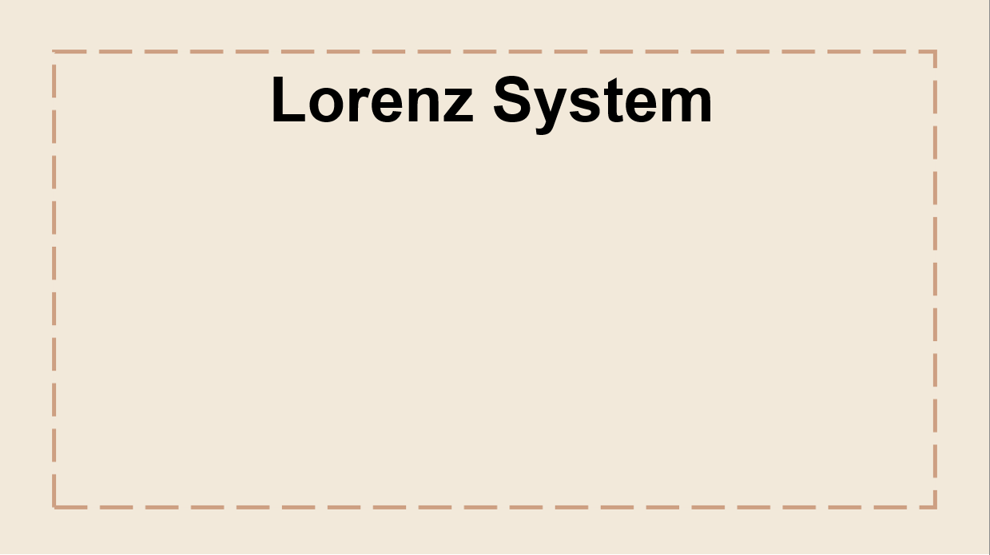
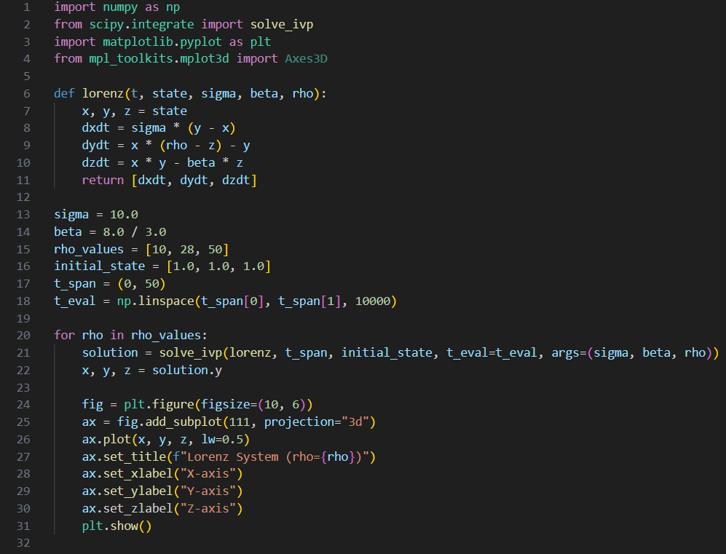
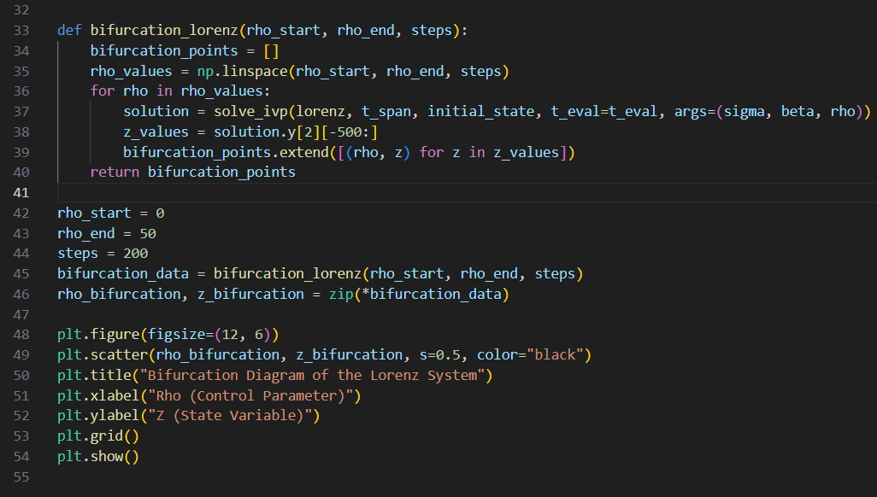
Python Code for Lorenz
System Simulation

Slide 13
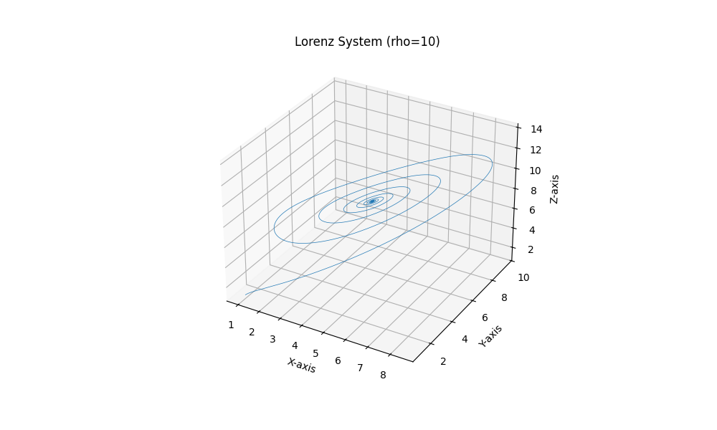
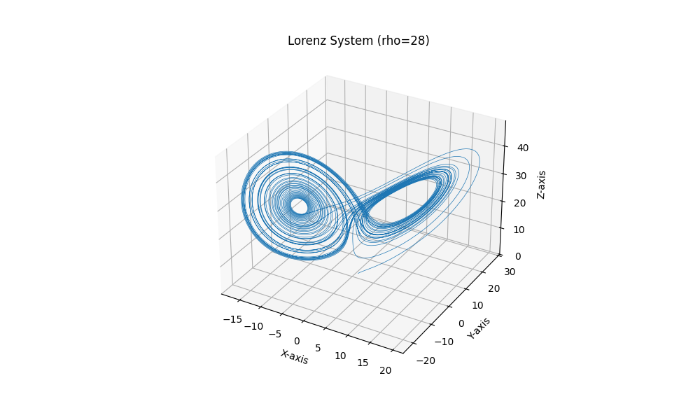
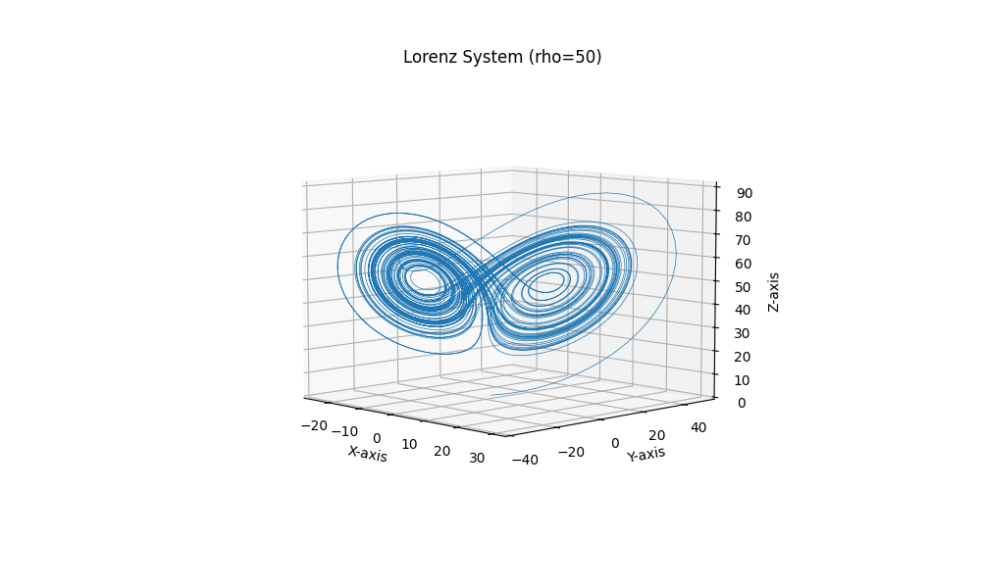
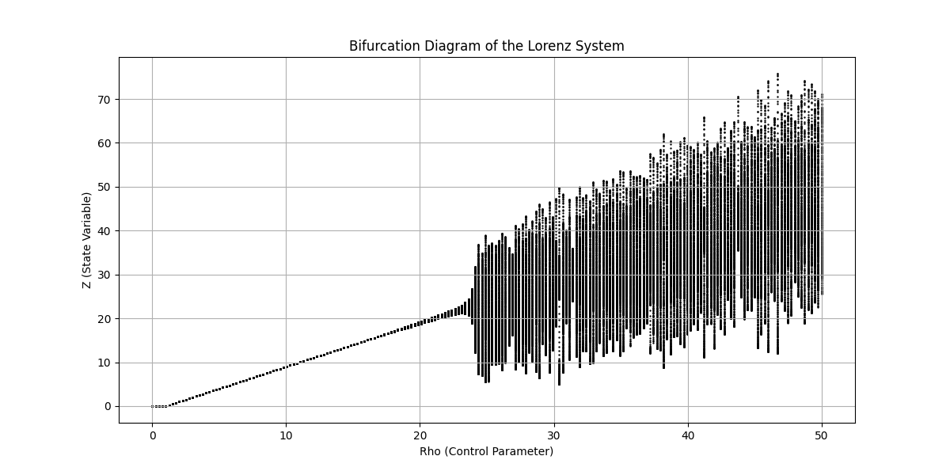
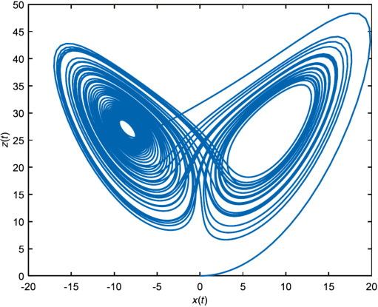
Output:
Actual 2-D
output

Slide 14
Hopf Bifurcation:
Occurs at a critical value of ρ=ρc, where the fixed points lose stability, giving rise to limit cycles (oscillatory solutions).
This marks the transition from steady-state behavior to periodic oscillations.
Route to Chaos:
As ρ increases further, the system undergoes more bifurcations, leading to chaotic behavior.
This chaotic regime is characterized by the emergence of the Lorenz attractor, a strange attractor with a fractal structure.
Strange Attractor:
The Lorenz attractor is a hallmark of chaos, visualizing the system’s sensitivity to initial conditions. Trajectories on the attractor never intersect, highlighting the deterministic yet unpredictable nature of the system.

Slide 15
Applications
Population Dynamics:
Used to predict population growth in environments with limited resources and carrying capacity.
Chaos Theory and Nonlinear Systems:
Demonstrates the transition from stability to chaos, aiding in the study of complex systems.
Cryptography:
Its chaotic behavior is applied to design secure cryptographic systems.
Weather Prediction and Climate Modeling:
Developed to model atmospheric convection, the Lorenz system demonstrates the unpredictability of weather patterns over time (the "butterfly effect").
Fluid Dynamics and Engineering:
Used to study turbulence and chaotic behavior in fluid flows and thermal convection systems.
Biology and Electronics:
Models chaotic behavior in biological systems (e.g., predator-prey interactions) and chaotic oscillations in electrical circuits.

Slide 16
Conclusion & Future Work
Bifurcation and Chaos Insight:
Both the Lorenz system and the logistic map reveal how small parameter changes can lead to significant qualitative shifts, transitioning from stability to chaos.
Practical Applications:
These models have wide-ranging applications in weather prediction, population dynamics, fluid mechanics, cryptography, and more.
Future Research Opportunities:
Continued exploration of these systems can further enhance our understanding of real-world chaotic phenomena and improve modeling techniques in science and engineering.
Future Work:
Extend analysis to higher-dimensional nonlinear systems.
Explore real-world applications, such as turbulence modeling and ecological systems.
Explore ways to control and reduce chaotic behavior in real-world systems.

Slide 17
THANK YOU
References: James Gleick, Chaos

